Slide 1
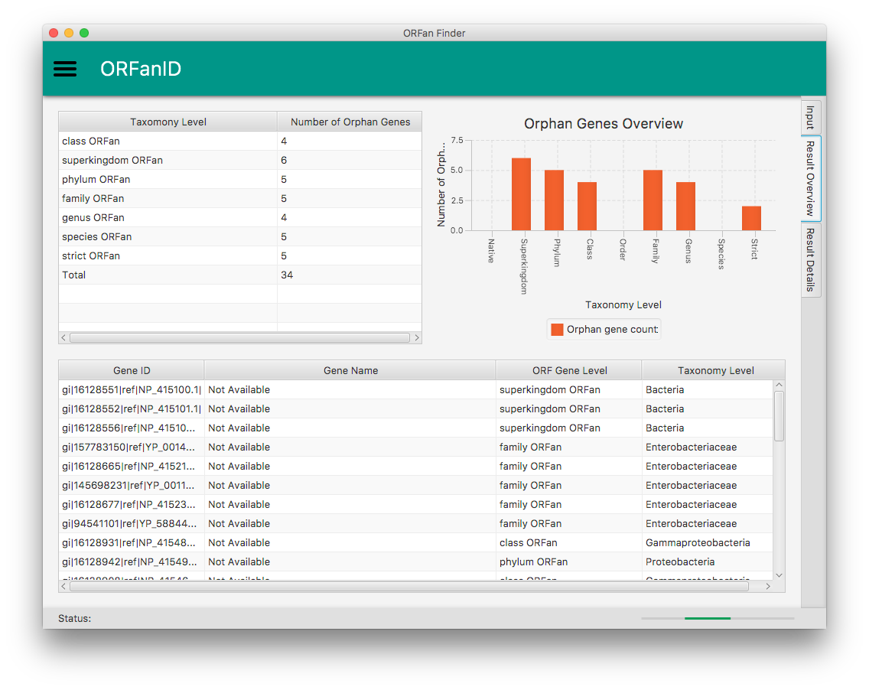
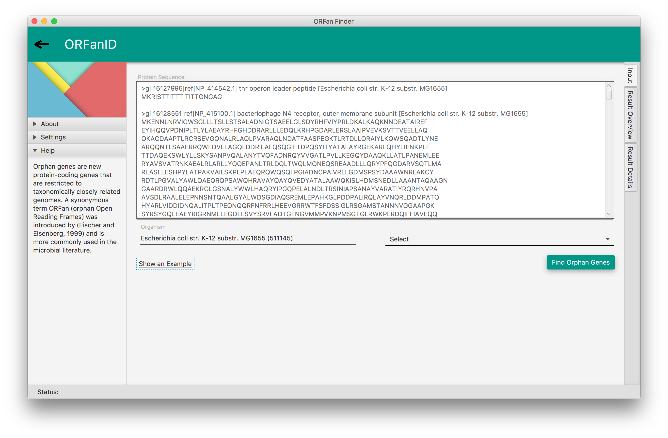
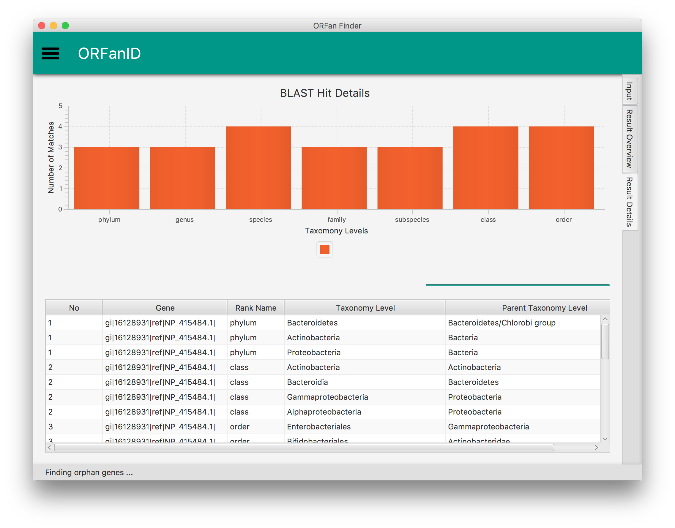
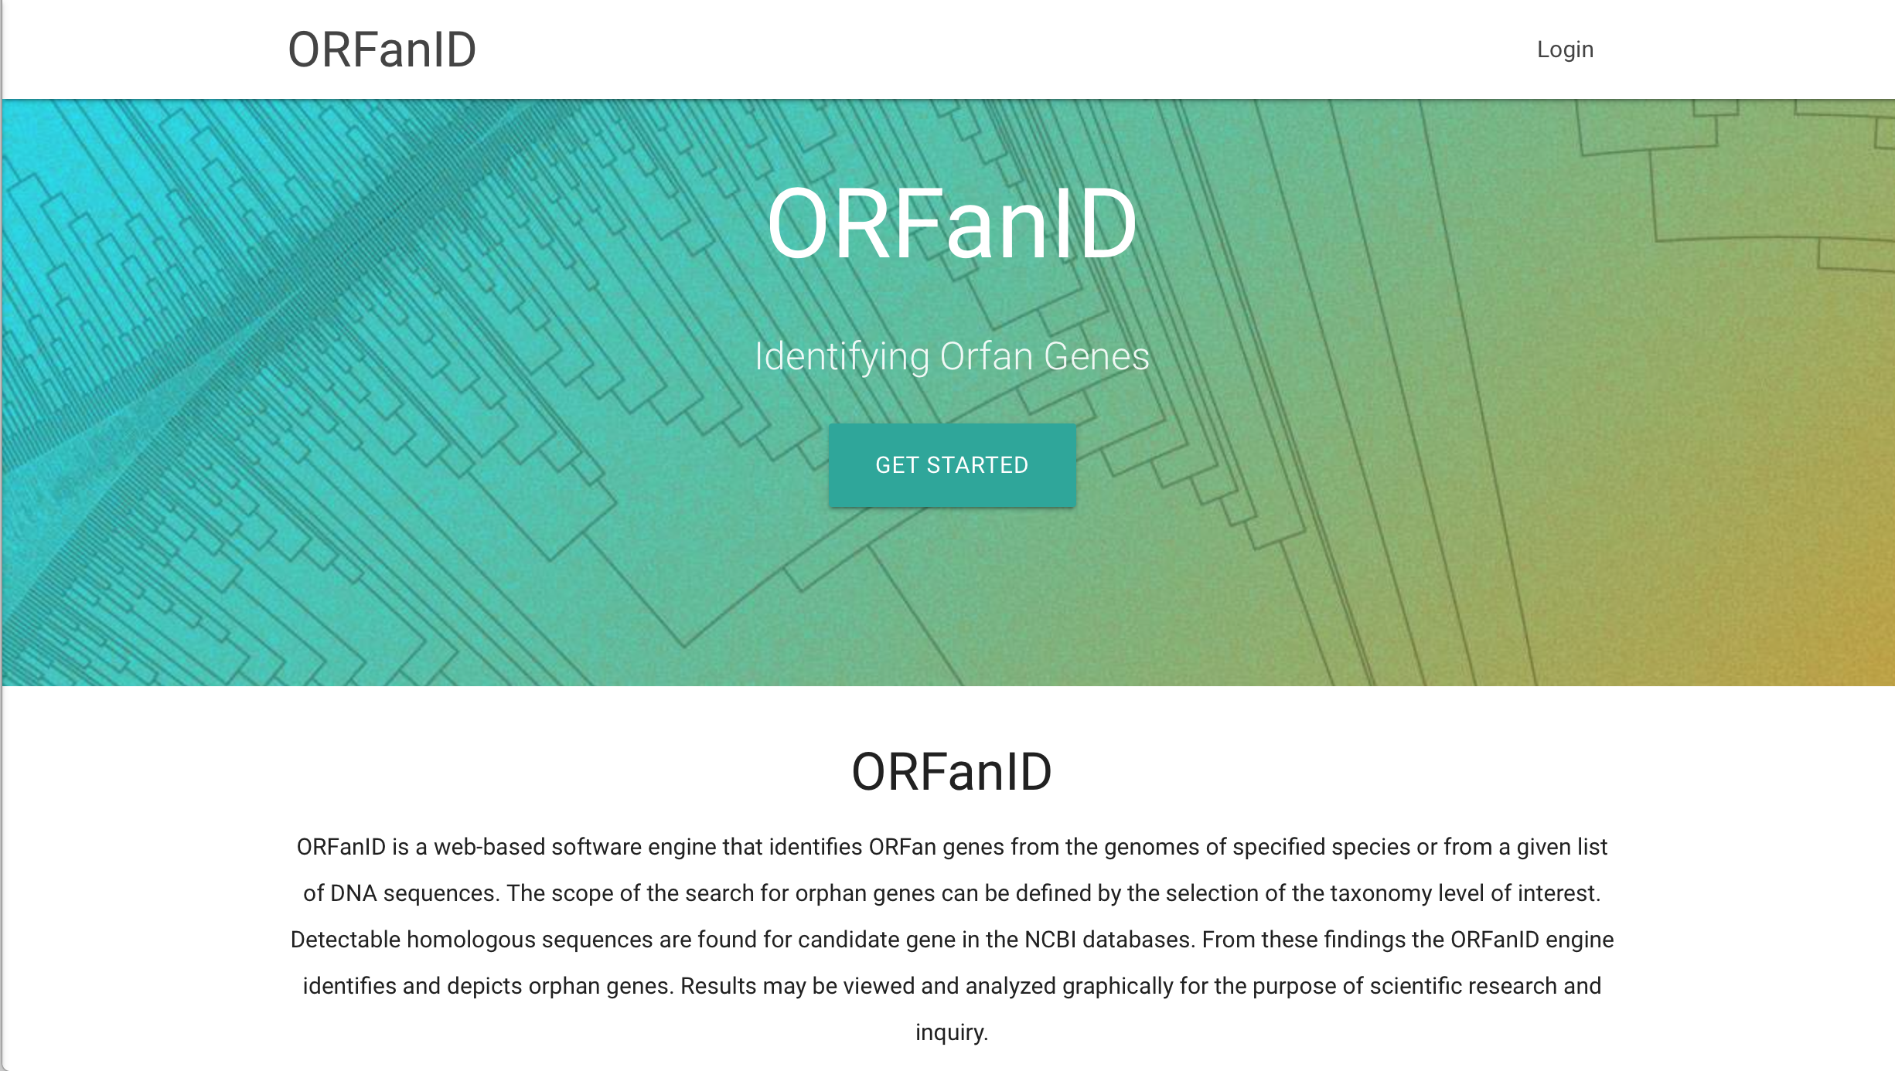
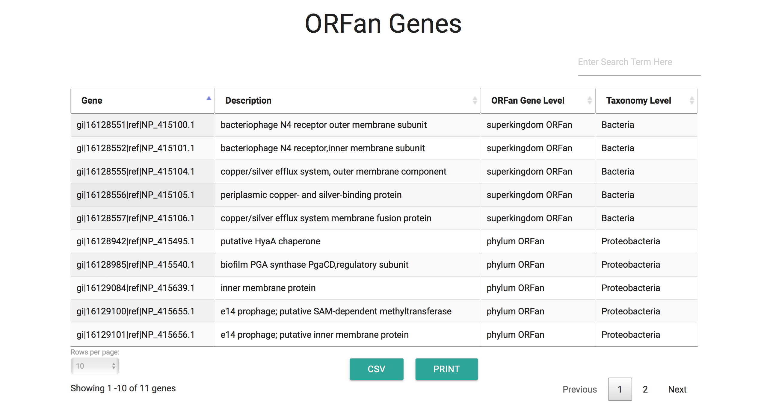
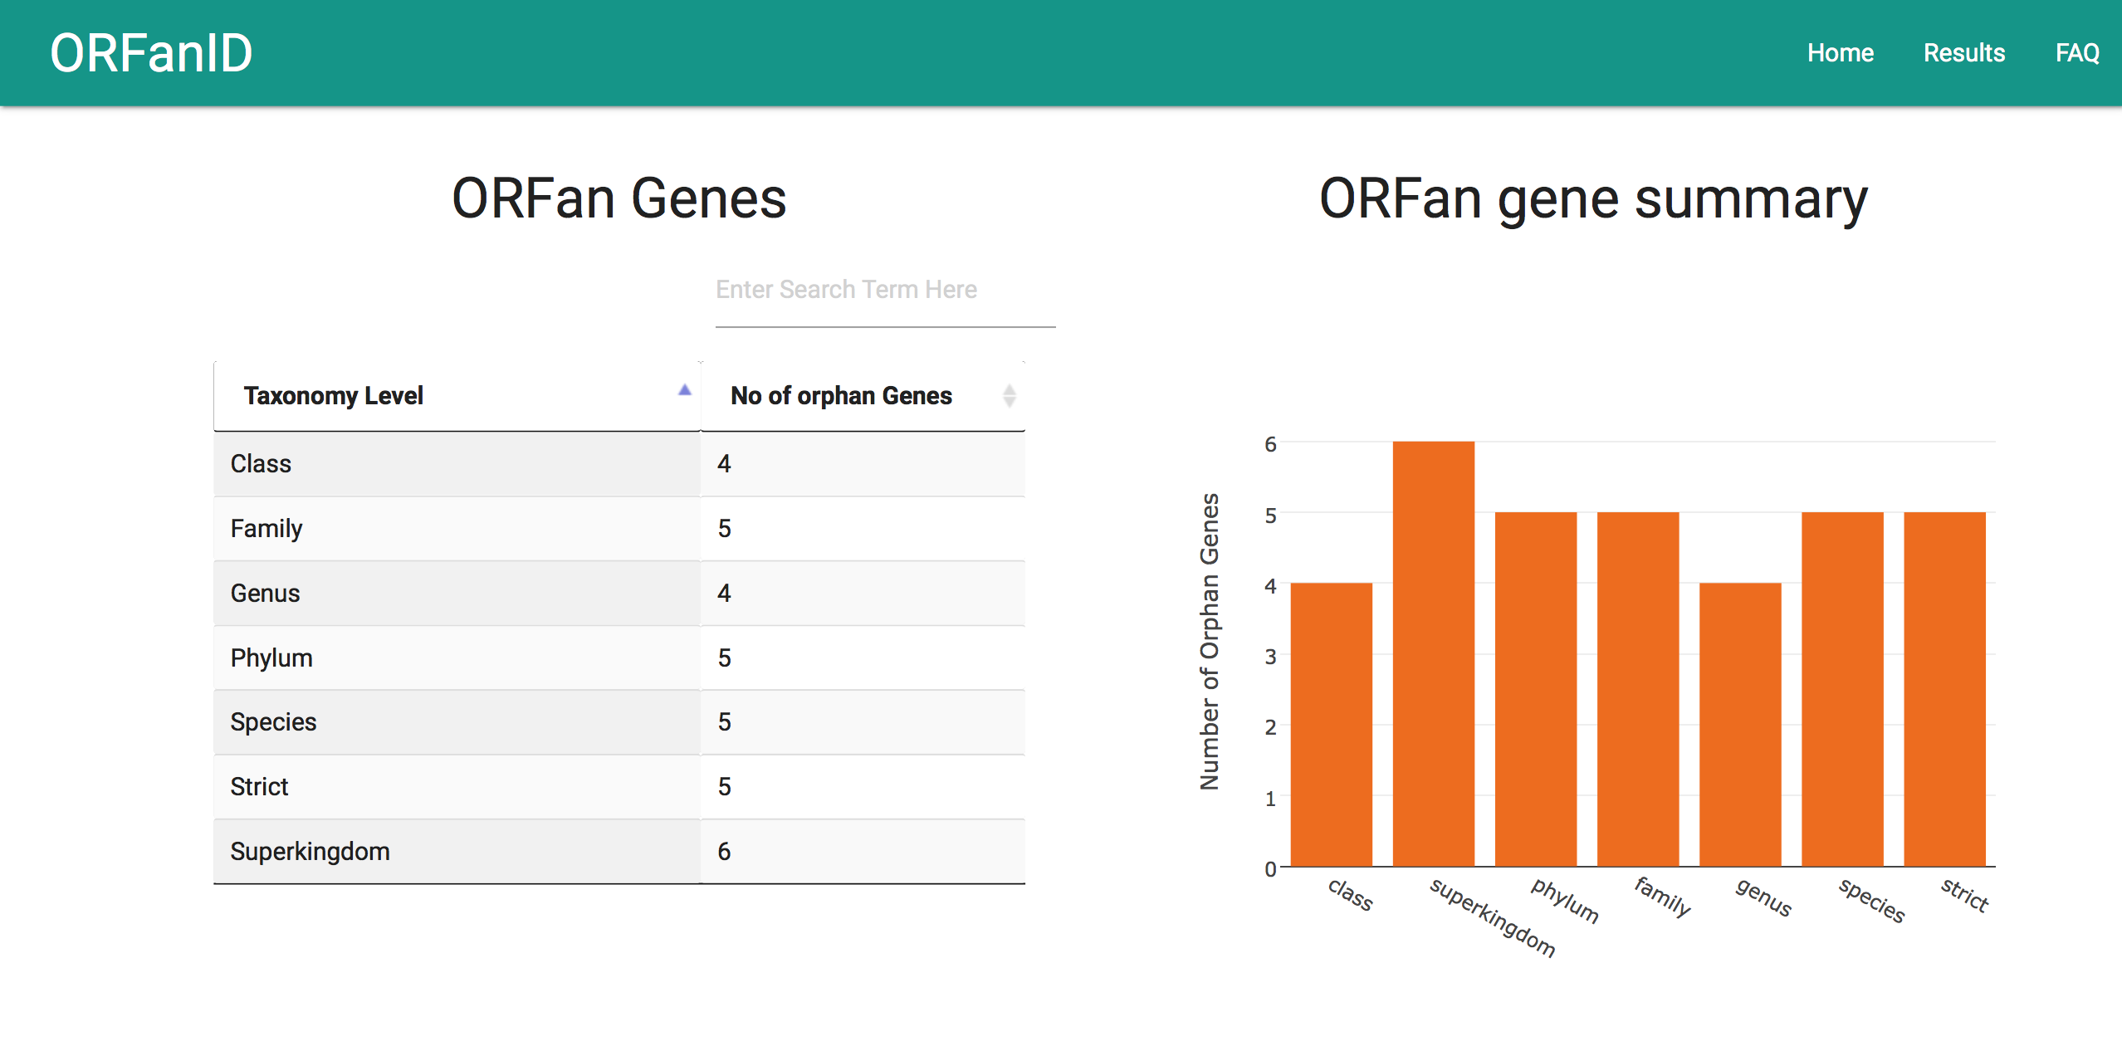
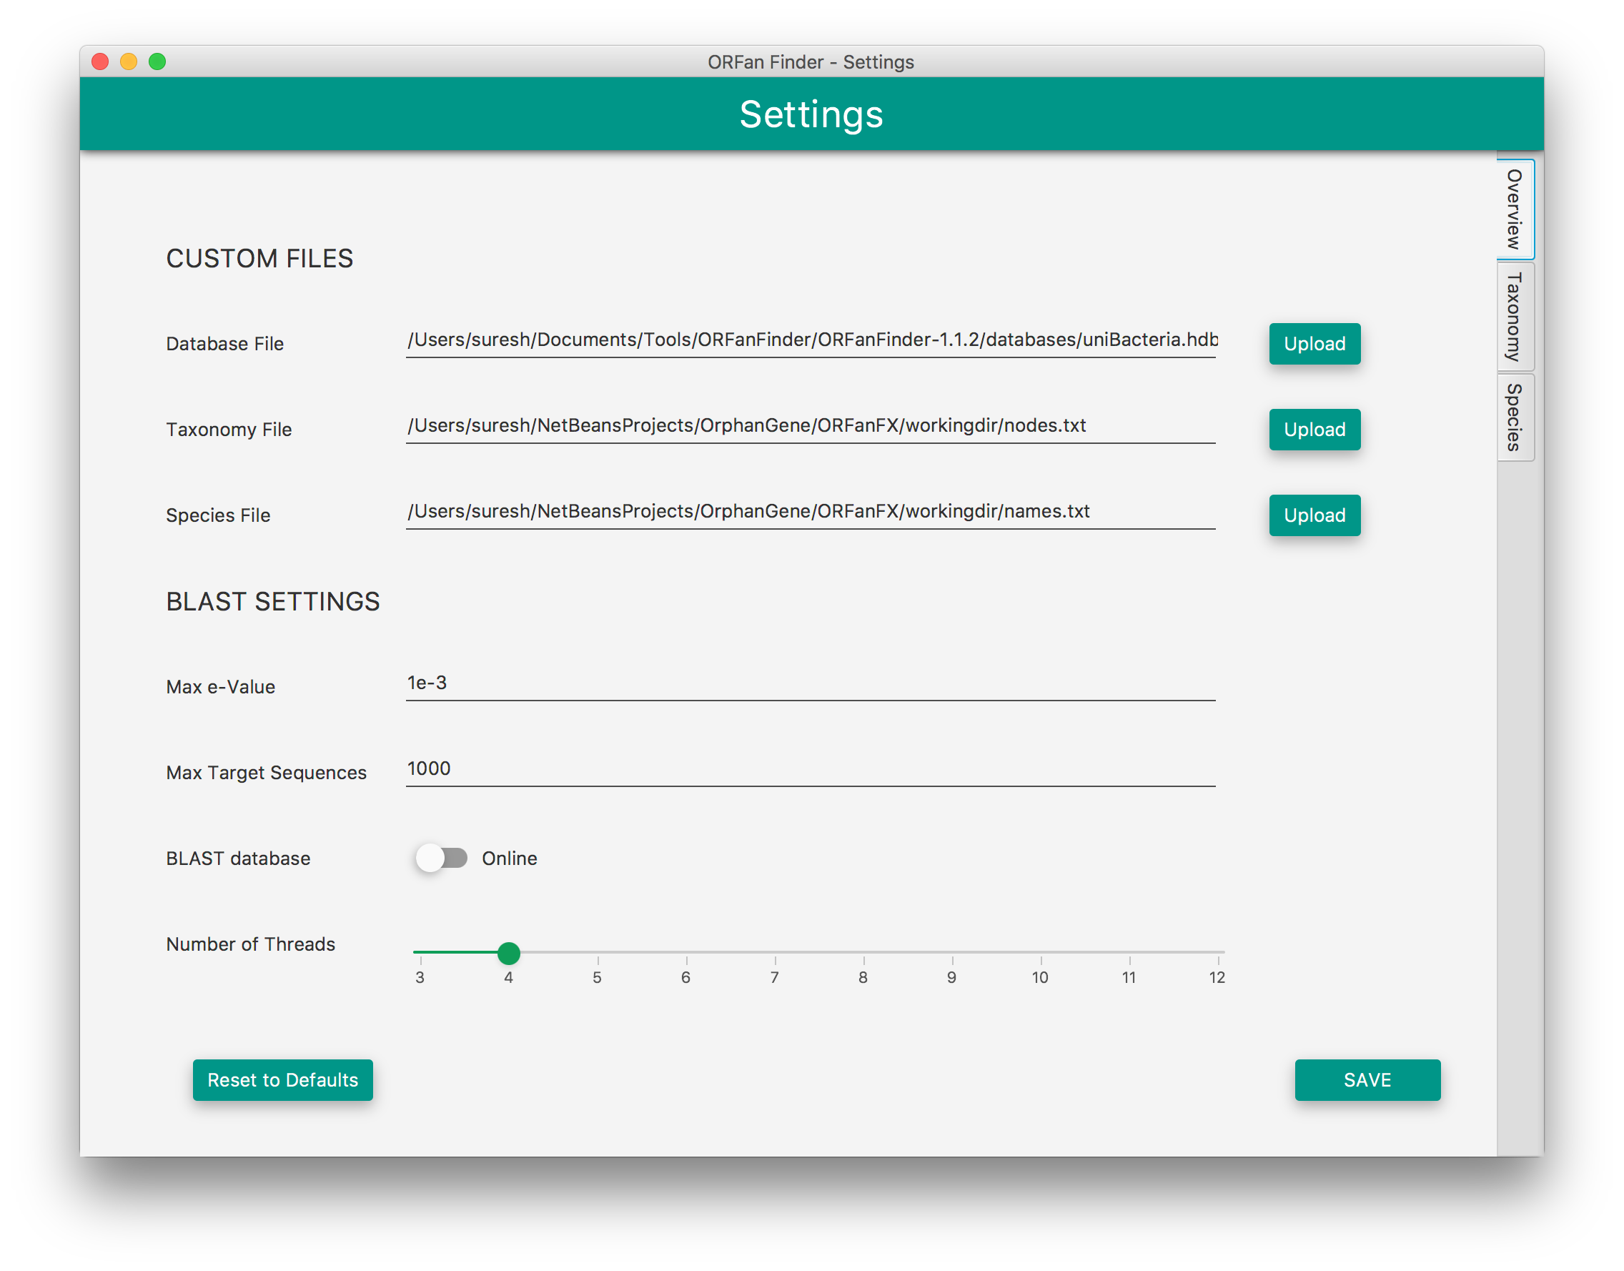
ORFanID: A Search Engine to Discover De Novo “Orphan” Genes
Richard S. Gunasekera, Ph.D.^{1,2}, Suresh Hewapathirana, M.Sc.³, Vinodh Gunasekera, M.E.E.³, and Paul Nelson, Ph.D⁴.
¹Departmant of Biological Sciences, University of Houston-Victoria, 3007 N. Ben Wilson Dr., Victoria, TX 77901, ²Rice University, 6100 Main St. Houston, TX 77005, ³Bioinformatics Consultants, Chesalon LLC, 5527 Theall Road, Houston, TX 77066, ⁴Biola University, 13800 Biola Avenue,
La Mirada, CA 90639
Introduction
Results
ORFanID is a standalone and web-based software engine that identifies ORFan genes from the genomes of specified species or from a given list of gene sequences. The scope of the search for orphan genes can be defined by the selection of the taxonomy level of interest. Detectable homologous sequences are found for candidate gene in the NCBI databases. From these findings the ORFanID engine identifies and depicts orphan genes. Results may be viewed and analyzed graphically for the purpose of scientific research and inquiry.
An example of the interactive visualization of the ORFanID is given below:
The top left table summarizes the results by showing the number of orphan genes found at each taxonomy level of the selected species (Bacteria, in this example) and the graph on the top right visualizes the same data graphically to improve analysis. The table at the bottom shows the categorization levels of the orphan genes discovered, along with the actual taxonomy level for each individual gene. Once the user selects a gene from the bottom table, the homologous sequence found from BLASTP will be displayed in a “Result Details” tab.
Methods and Procedures
ORFanID accepts the amino acid sequence of a single or multiple gene sequence in the FASTA format with their NCBI gene IDs(gi) in the headers, name of the organism and the taxonomy level of the selected organism to restrict the BLAST search. All the existing organism names in NCBI Taxonomy database will be loaded offline to the organism textbox with autocomplete functionality.
The table at the bottom of this window shows the taxonomy levels of different homologous BLAST hits for the selected gene. The number of BLAST matches for each taxonomy are interactively visualized in the chart. For example, if there are hits for the Family level, but not in Phylum, Class, Order, then that gene is specifically restricted to Family, therefore it’s a Family level orphan gene. All the tables in the software are sortable by column and results can be easily filtered with a fuzzy search functionality.
Preprocess
Extract gene IDs from the input FASTA
BLAST
Silimarity search using BLASTP+ programme
ORFanFinder
Categorise Orphan genes based on BLAST results
Visualization
Format ORFanFinder output for visualization
ORFanID engine executes several scripts as a pipeline as follows:
ORFanID Web-based application^{[5]} provides additional functionality such as table pagination, exporting results as PDF or CVS formats.
The execution sequence is as follows:
ORFanID extracts the NCBI gene ID(s) from the header(s) of the input FASTA file.
All the genes are submitted to the online NCBI BLASTP^{[1]} program to find homologous sequence against the NCBI non-redundant protein database. Accuracy of the results can be adjusted based on e-value and maximum number of targets sequences and the taxonomy level (to restrict the search), and the results will be reported in a tabular format. Those parameters can be changed from the settings section which has illustrated on the figure below.
Genes will be categorized according to a filtering algorithm by the ORFanFinder command-line tool^{[2]} , based on the homology sequences found from blast results.
Output of the ORFanFinder is formatted to produce tables and charts for interactive analysis and visualization. ORFanID web-based application produces few JSON files to store these results and load them into the client’s browser.
Discussion
Add text here
Interfaces of both standalone and web application have developed according to Google Material guidelines. Moreover, Materialised CSS^{[3]} and Plotly.Js^{[4]} Jquery libraries were used in the web-based application and the standalone application was built on JAVAFX to enhance the user experience.
Reference
[1]. https://blast.ncbi.nlm.nih.gov/Blast.cgi [2]. http://cys.bios.niu.edu/orfanfinder/
[3]. http://materializecss.com [4]. https://plot.ly [5]. http://orfangenes.com
http://orfangenes.com

